Slide 1
Topic 8 – Linked Lists

Slide 2
Why are arrays limited?
Every data structure we have considered thus far has involved these of arrays
The main problem with arrays is that in order to move an item from
one slot to another it has to be copied, pasted and deleted
This is very time consuming – can we come up with an alternative that avoids this process?
Copy and paste
1
3
7
8
9
5
insert

Slide 3

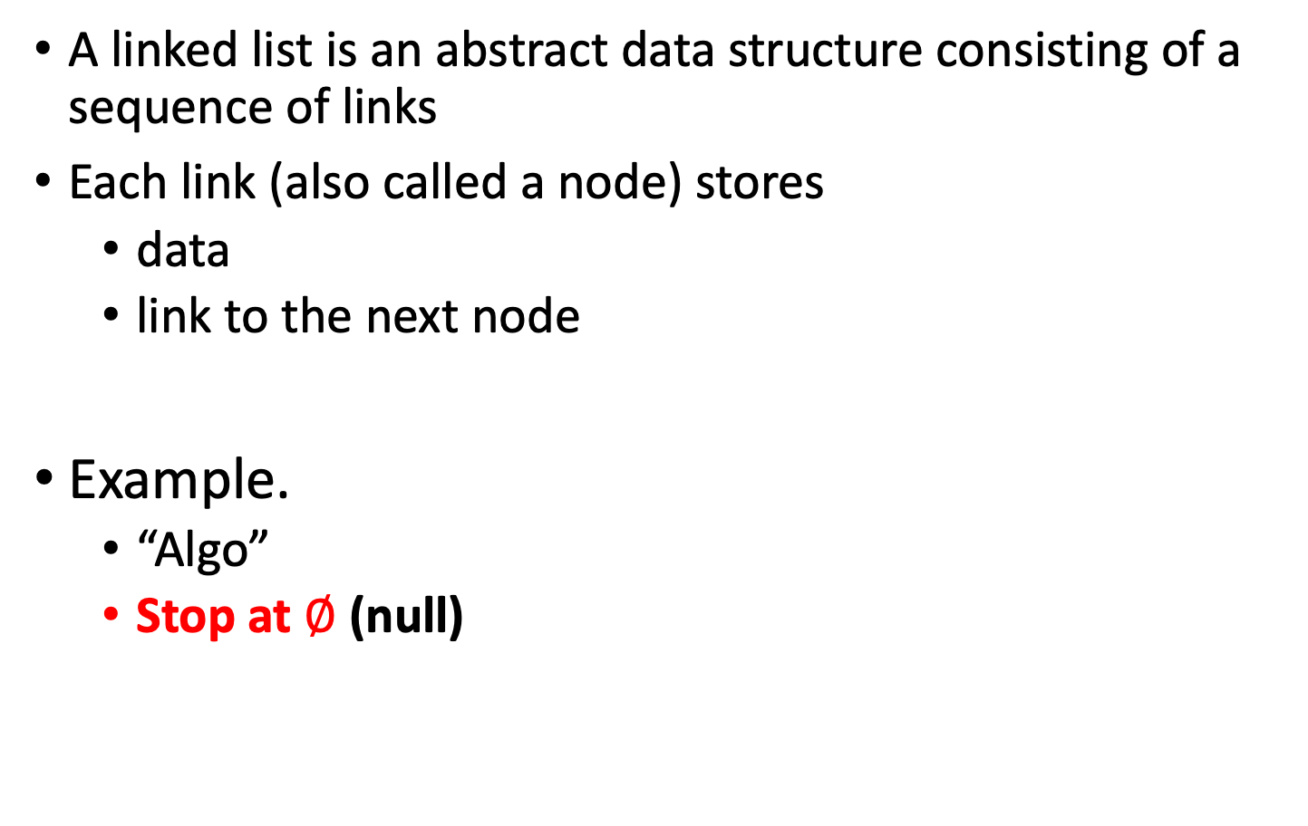
Linked List
A linked list is an abstract data structure consisting of a sequence of links
Each link (also called a node) stores
data
link to the next node
Example.
“Algo”
Stop at $∅$ (null)
data
next node
link to the next node
data
A
l
g
o
$$∅$$

Slide 4
Advantages
Why are linked lists better than arrays?
Problems of array:
Arrays waste space because they aren’t always full
For example, you set “int arr[1000]” to store score of this class. But this class only have 50 students. Then the slots from arr[50] to arr[999] will not use.
When they get full it is not easy to extend them
If you want to insert a new element in a particular slot you have to copy all the items that need to be moved

Slide 5
Advantages
Why are linked lists better than arrays?
Problems of array:
waste space
not easy to extend an array
to insert a new element is not easy
Linked lists avoid all of these problems because they can adapt their ordering by changing the items they point to – no memory is wasted and extra links can easily be added

Slide 6
Structure
One special type of class called Linked List stores the first or anchor link for all the subsequent Link objects
A Linked List object is instantiated to point to the start of the list and multiple
Link objects are created for each link in the list
All contain references to the next link in the list

Slide 7

Structure
The Linked List class stores a reference to the first link
The Link class stores a bit of data and a reference to the next link
Linked List
Link
Link
Link
first
data
next
data
next
data
next
$$∅$$
public LinkedList( ) {
first = null;
}

Slide 8

Java Implementation
class LinkedList {
private Link first;
public LinkedList( ){
first = null;
}
public boolean isEmpty( ){
return (first == null);
}
……
}
Linked list only contains a reference to the first link
This is originally set to null
Linked List
Link
first
data
next
$$∅$$

Slide 9
Java Implementation
Linked List
Link
public class Link {
public int data;
public Link next;
public Link(int datain) { // constructor
data = datain; // initialize data
// 'next' is automatically set to null
}
}
Note that although the Link object contains another Link (next), this is only a reference to the next Link
This is the same for any object, the label (e.g. next) is only a reference and does not represent the actual object itself
next = new Link( ): next acts as a reference to this object which is created somewhere else in memory
first
data
next
$$∅$$

Slide 10
Inserting at the Head
The head is the first link
The tail is the last link
When inserting or removing links we always take care not to break the chain
1. Create a new link
2. Have new link point to old first link
3. Update Linked List to point to new link

Slide 11


Inserting at the Head
1. Create a new link
2. Have new link point to old first link
3. Update Linked List to point to new link
first
Dad
next
Tom
next
Kid
next
$$∅$$
insert
first
Dad
next
Tom
next
kid
next
$$∅$$

Slide 12
Insert at Head
first
Dad
next
Tom
next
public void insertHead (int number) {
Link newLink = new Link(number);
newLink.next = first;
first = newLink;
}
This insertHead( ) method in LinkedList does the following
takes in a number
creates a new link with that piece of data
sets that link to point to the old first link
sets the first link to point to the new link
insert
first
Dad
next
Tom
next

Slide 13


Deleting at the Head
Update head to point to next node in the list
Garbage collector will now reclaim the former first node
Linked List
next
Dad
next
Tom
next
Jojo
next
Kid
next
$$∅$$
Linked List
next
Dad
next
Tom
next
Jojo
next
Kid
next
$$∅$$

Slide 14


Deleting at the Head
Linked List
next
Dad
next
Tom
next
Jojo
next
Kid
next
$$∅$$
Linked List
next
Dad
next
Tom
next
Jojo
next
Kid
next
$$∅$$
Linked List
next
Tom
next
Jojo
next
Kid
next
$$∅$$

Slide 15
Delete at Head
Linked List
next
public Link deleteHead () {
Link temp = first;
first = first.next;
return temp;
}
This method in LinkedList does the following
Backs up the first link
Gets the link after the first link
Puts the old first link equal to that
Returns the link that has been ‘bypassed’
Dad
next
Tom
next
Linked List
next
Dad
next
Tom
next

Slide 16
Traversing a linked list
With arrays, each item occupies a particular slot, and we can index any slot we like
With a linked list, you have to start at the beginning of the chain and work your way along in order to find an item
Binary search not possible – big disadvantage of linked lists
public void display {
Link current = first; // start with first link
while(current != null) {
current.displayLink(); //print out the link
current = current.next; //keep going until you come to the end
}
}

Slide 17
Finding a link
What if we want to find or delete one particular node?
The algorithm works like this:
Take in the value to be found or deleted
Start at the beginning of the list
Keep moving down the links until we find the correct one
All the while keep tracking the current link and the previous link (so we can join them up when required)
Now update the references to bypass the link to be deleted

Slide 18

Removing a Node From the Middle of a Linked List
Removing a Node From the Middle of a Linked List
Linked List
next
remove
Dad
next
Tom
next
Jojo
next
Kid
next
$$∅$$
+

Slide 19
Removing a Node From the Middle of a Linked List
public Link delete(int key) { // delete link with given key
Link current = first; // search for link
Link previous = first; //put these equal to first Link
while(current.data != key) {
if(current.next == null) { return null; } // didn't find it
else {
previous = current; // go to next link
current = current.next;
}
} // found it
if(current == first){ // if first link,
first = first.next; // change first
} else{ // otherwise,
previous.next = current.next; // bypass it
}
return current;
}
//NOTE: Assumes list is not empty

Slide 20

Double-Ended Linked Lists
A double-ended list is similar to an ordinary linked list with one additional feature
It as a reference to the last link as well as the first
This allows a new link to be inserted or deleted at the end as well as the beginning
Handy for implementing a queue (items arrive one end and leave at the other)
Linked List
next
next
Dad
next
Tom
next
Jojo
next
Kid
next
$$∅$$

Slide 21
Double-Ended Linked Lists
A double ended Linked List class will have the following variables
first
last
It will have the following methods
insertFirst(int data)
insertLast(int data)
deleteFirst( )
deleteLast( ) (requires a doubly-linked list)
In these methods, the variables first and last are updated accordingly

Slide 22




Inserting at the Tail
tail
Create a new link
Have new link point to null
Have old last link point to new node
Update tail of Linked List object to point to new node
Linked
List
data
data
head
next
next
$$∅$$
tail
insert
Linked
List
data
data
data
head
next
next
$$∅$$
$$∅$$
tail
Linked
List
data
data
data
head
next
next
next
$$∅$$

Slide 23


Removing at the Tail
Removing at the tail of a singly-linked double ended list is not efficient!
There is no constant time way to update the tail to point to the previous node
We need to use double links (that point to both next and previous link)
tail
Linked
List
data
data
data
head
next
next
next
$$∅$$
tail
Linked
List
data
data
head
next
next
$$∅$$

Slide 24
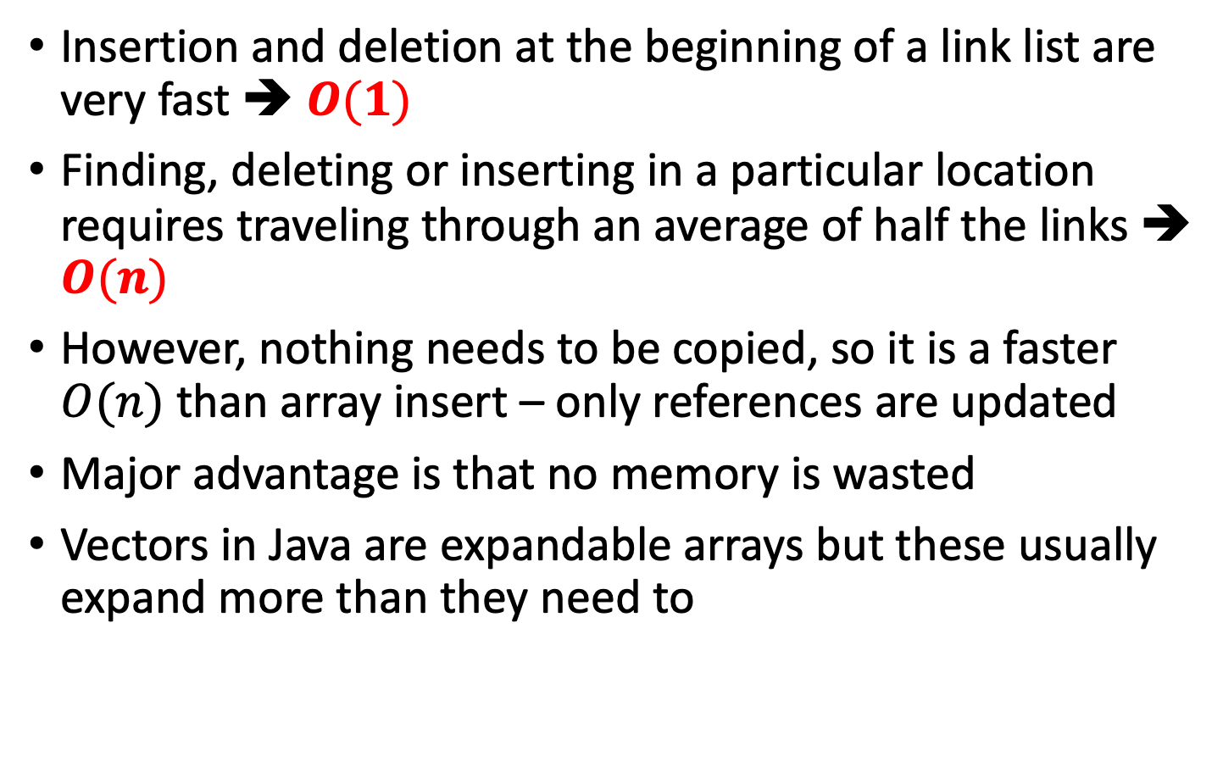
Linked-List Efficiency
Insertion and deletion at the beginning of a link list are very fast ➔ $O(1)$
Finding, deleting or inserting in a particular location requires traveling through an average of half the links ➔ $O(n)$
However, nothing needs to be copied, so it is a faster $O(n)$ than array insert – only references are updated
Major advantage is that no memory is wasted
Vectors in Java are expandable arrays but these usually expand more than they need to

Slide 25
Abstraction
It doesn’t matter if we implement the stack or queue using an array or linked list
In object-oriented programming an Abstract Data Type (ADT) is considered without regard to its implementation
We only want to know how to use the methods, not how they carry out their tasks
The ADT specification is called the interface (e.g. in a stack these would be push( ) and pop( )

Slide 26

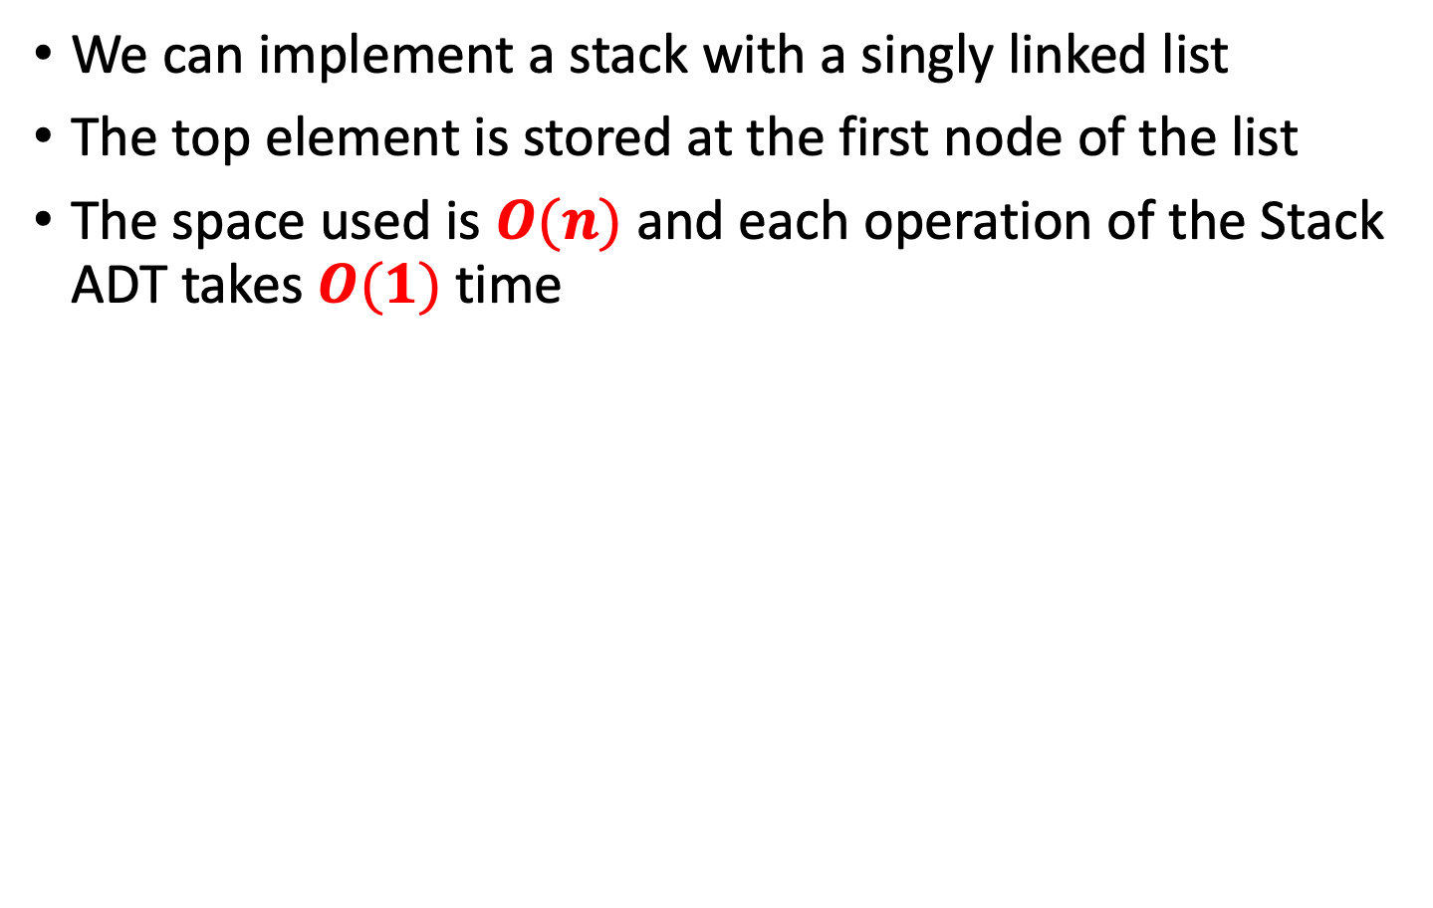

Stack with a Singly Linked List
We can implement a stack with a singly linked list
The top element is stored at the first node of the list
The space used is $O(n)$ and each operation of the Stack ADT takes $O(1)$time
links
top
$$∅$$
elements

Slide 27
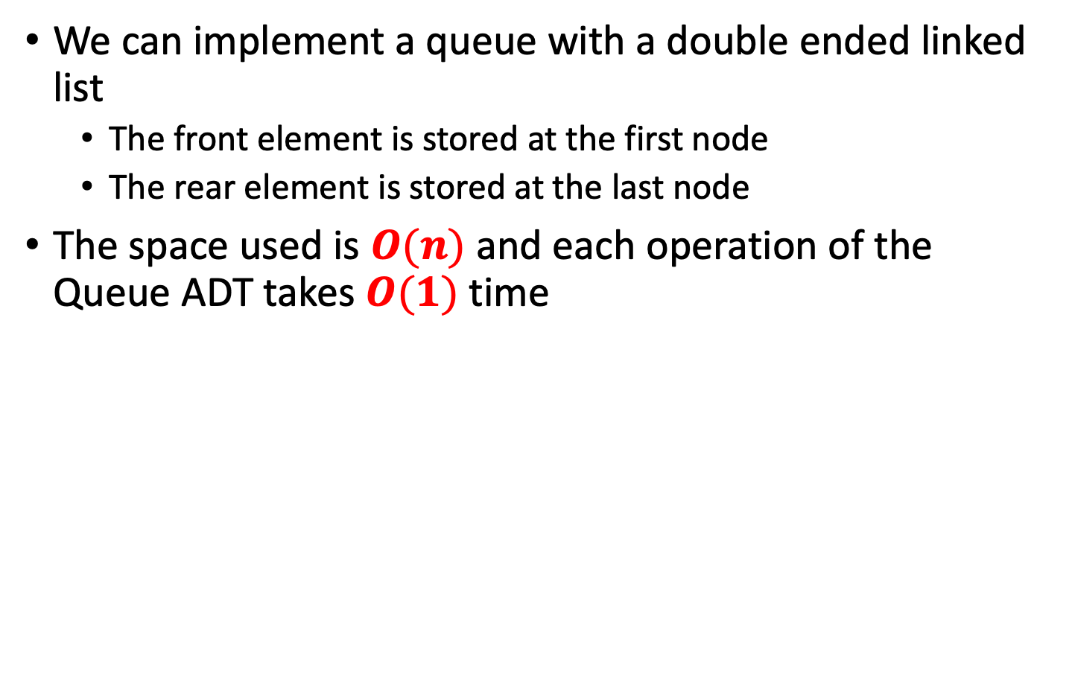
Queue with a Singly Linked List
We can implement a queue with a double ended linked list
The front element is stored at the first node
The rear element is stored at the last node
The space used is $O(n)$ and each operation of the Queue ADT takes $O(1)$ time
rear
links
front
$$∅$$
elements

Slide 28
Sorted Lists
Remember the priority queue – this required the items to be sorted
In order to keep a linked list sorted, we have to insert at particular locations
Only way to find the correct location is to search through the list – can’t use binary search
When you find the correct location (i.e. when you find a value bigger than the one you want to insert) update the pointers of the relevant links

Slide 29
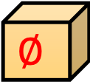
Insertion
After finding the correct location for the item we must update the pointers
The new element must be set to point to the next element in the linked list
The previous element must be updated to point to the new element
insert
Jojo
next
first
Dad
next
Tom
next
Kid
next
$$∅$$
Jojo
next
first
Dad
next
Tom
next
Kid
next
$$∅$$

Slide 30
Insertion to ordered list
public void insertOrdered(Link newlink) { // insert (in order)
Link previous = null; // start at first
Link current = first; // until end of list
while(current != null && newlink.data > current.data) { // while key > current
previous = current;
current = current.next; // go to next item
}
if(previous==null) { // at beginning of list
first = newlink; // first --> newlink
}
else{ // not at beginning
previous.next = newlink; // old prev --> newlink
newlink.next = current; // newlink --> old current
}
} // end insert()

Slide 31
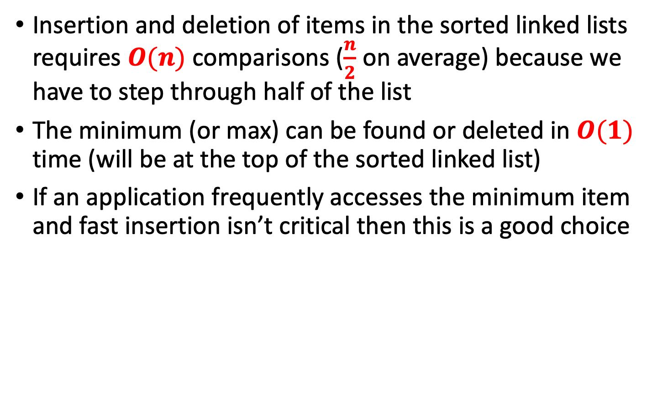
Efficiency of Sorted Linked Lists
Insertion and deletion of items in the sorted linked lists requires $O(n)$ comparisons ($\frac{n}{2}$ on average) because we have to step through half of the list
The minimum (or max) can be found or deleted in $O(1)$ time (will be at the top of the sorted linked list)
If an application frequently accesses the minimum item and fast insertion isn’t critical then this is a good choice

Slide 32
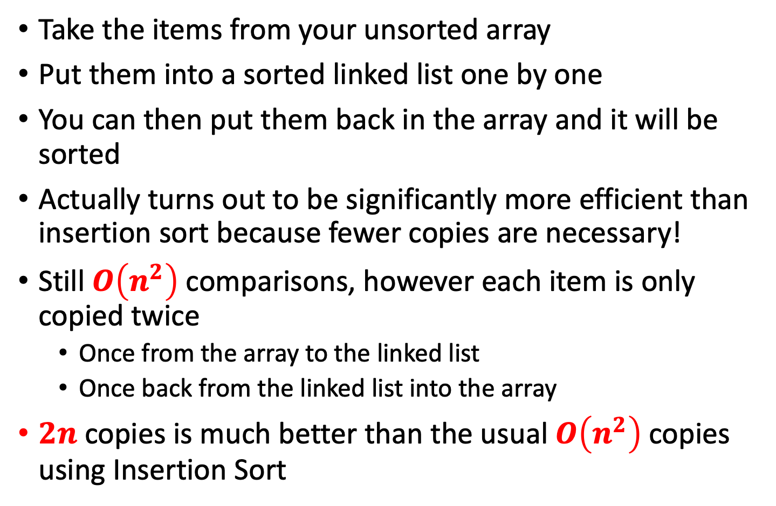
Using linked lists for array sorting
Take the items from your unsorted array
Put them into a sorted linked list one by one
You can then put them back in the array and it will be sorted
Actually turns out to be significantly more efficient than insertion sort because fewer copies are necessary!
Still $O\left(n^{2}\right)$ comparisons, however each item is only copied twice
Once from the array to the linked list
Once back from the linked list into the array
$2n$ copies is much better than the usual $O\left(n^{2}\right)$copies using Insertion Sort

Slide 33
Doubly Linked Lists
Removing an element at the tail of a singly linked list is not easy since
We can’t move backwards!!!
Indeed, there are many times we need to know the predecessor as well as the successor of a particular node
A linked list where you can traverse it forwards or backwards is a doubly linked list (references going both ways)

Slide 34
Double-Ended Doubly Linked Lists
Linked
List
last
data
data
data
data
first
next
next
next
next
$$∅$$
$$∅$$
prev
prev
prev
prev

Slide 35

Double-Ended Doubly Linked Lists
The specification for the link class now looks like this:
public class Link {
public int data;
public Link next;
public Link previous;
}
Now every time we insert or delete a link, we must deal with four links instead of two
Update the two attachments between the previous link and the new one
Update the two attachments between the next link and the new one
Now we can move backwards or forwards through the list
Linked
List
last
data
data
data
first
next
next
next
$$∅$$
$$∅$$
prev
prev
prev

Slide 36
Insertion at beginning
1. – Change prev of first link
2. – Change next of new link
3. – Change first of Linked List
Step 3 must be last or chain would be lost!!!
Linked
List
last
data
data
data
data
insert
first
next
next
next
next
$$∅$$
3.
data
prev
prev
prev
prev
2.
next
1.
prev
$$∅$$

Slide 37
Java Implementation
public void insertHead(long data) { // insert at head
Link newLink = new Link(data); // make new link
if( isEmpty() ) { // if empty list,
last = newLink; // newLink <-- last
}
else {
first.previous = newLink; // newLink <-- old first
}
newLink.next = first; // newLink --> old first
first = newLink; // first --> newLink
}

Slide 38
Insertion in order
1. – Change prev of new link
2. – Change next of left link
3. – Change next of new link
4. – Change prev of right link
Linked
List
last
data
data
data
data
first
next
next
next
next
$$∅$$
$$∅$$
prev
prev
2.
3.
prev
prev
insert
data
next
1.
4.
prev

Slide 39
Java Implementation
public void insertOrdered(long data) { //inserts data in order
Link current = first; // start at beginning
while(current!=null && data > current.data) { current = current.next;
} // move to next link
Link newLink = new Link(data); // make new link
if(current==first) { // if insertion at head
insertHead(data);
} else if(current==last){ //if insertion at tail
insertTail(data);
} else { // somewhere in middle
newLink.previous = current.previous; // step 1
current.previous.next = newLink; // step 2
newLink.next = current; // step 3
current.previous = newLink; // step 4
}
}

Slide 40
Deletion
1. – Change next of left link
2. – Change prev of right link
Linked
List
last
data
1.
data
data
first
next
next
next
$$∅$$
$$∅$$
prev
prev
prev
2.

Slide 41
Java Implementation
public Link delete (long key) { // delete item with given key
Link current = first; // start at beginning
while(current.data != key){ // until match is found
current = current.next; // move to next link
}
if(current == null){ return null; } // didn't find it
if(current == first){ // found it; first item?
first = current.next; // first --> old next
} else { // not first. // old previous --> old next
current.previous.next = current.next;
}
if(current==last){ // last item?
last = current.previous; // old previous <-- last
} else { // not last item // old previous <-- old next
current.next.previous = current.previous;
}
return current; // return value
}

Slide 42
Iterators
In order to find a link we started at the beginning and searched all the way through
This doesn’t give the user any control over the items passed over
Suppose you want to traverse a list and perform some operation on certain link
Increase the wages of all employees being paid the minimum without affecting anyone else’s
Delete all customers in a database who haven’t ordered anything for the past six months
This is easy in an array because every element has a fixed index
We need a method that can step from link to link performing an action on each one

Slide 43
List Iterator
Iterators always point to some link in the list
They are associated with the list but are not part of it
Linked
List
data
data
data
data
first
next
next
next
next
$$∅$$
current
current
Iterator 1
Iterator 2

Slide 44
Iterator Class
Objects containing references to items in data structures, used to traverse these structures, are commonly called iterators
The main advantage of using an object is that we can create as many references as we want
class ListIterator() {
private Link current;
…
}
It easiest to get the linked list class to create the iterator so we add a getIterator( ) method to it
LinkedList theList = new LinkedList();
ListIterator iter1 = theList.getIterator();
Link aLink = iter1.getCurrent(); //access link at iterator
iter1.nextLink(); // move iterator to next Link

Slide 45
Additional Iterator Features
We’ve seen that’s it’s handy to store a reference to the previous link
If our linked list isn’t doubly-linked then the iterator should store both current and previous so that it can delete links
It is also handy for the iterator to store a reference to the linked list class so it can access the first element of the list

Slide 46
Iterator Code
class ListIterator {
private Link current; // current link
private Link previous; // previous link
private LinkList ourList; // our linked list
public ListIterator(LinkList list) { // constructor
ourList = list;
reset();
}
public void reset() { // start at 'first'
current = ourList.getFirst();
previous = null;
}
public void nextLink() {
previous = current; //set previous to this
current = current.next; //set this to next
}

Slide 47
Iterator Methods
Additional methods can make the iterator a flexible and powerful class
All operations that involve iterating through the list are more naturally performed by the iterator
reset() – Sets the iterator to the start of the list
nextLink() – moves the iterator to the next link
getCurrent() – returns the link at the iterator
atEnd() – returns true if iterator is at end of list
insertAfter() – inserts a new link after the iterator
insertBefore() – inserts a new link before the iterator
deleteCurrent() – deletes the link at the iterator

Slide 48

Removing a Link using the Iterator
Removing a Link From the Middle of a Linked List
Linked
List
data
data
data
data
first
next
next
next
next
$$…$$
ListIterator
1.
previous
position
Linked
List
data
data
data
data
first
next
next
next
next
$$…$$
ListIterator
1.
previous
2.
position

Slide 49
Adding a Link Using an Iterator
Adding a Link to the Middle of a Linked List
Linked
List
data
data
data
data
first
next
next
next
next
2.
ListIterator
data
previous
newNode = ____
1.
position
next
Linked
List
data
data
data
data
first
next
next
next
next
4.
2.
ListIterator
data
previous
newNode = ____
1.
3.
next
position

Slide 50
Where does the Iterator point?
When you delete an item, should the iterator point to the next item, previous item, or back to the beginning of the list?
Keeping it in the vicinity is usually convenient
However, can’t set it to the previous item because there’s no way to reset the iterator’s previous field to the one before that (unless it’s doubly linked)
Move it to the next item, and back to the start if you’ve just deleted the last item

Slide 51
The atEnd() Method
Does this return true when the iterator points to the last valid link or when the iterator points past the last link?
If it points past the last link, then you can’t do anything with that link
You also can’t back up an iterator in a singly linked-list (e.g. you couldn’t search for the last link and then delete it)
The better approach is to make sure that the iterator always points to a valid link – should return true when it points to the last valid link (has to always check if next is null)

Slide 52
Stacks using Linked Lists
Implement a stack structure for reversing a word using a single-ended singly-linked list
We need a single-ended singly-linked list where we can insert and delete at the head
Linked
List
first
data
next
data
next
data
next
data
next
$$∅$$

Slide 53
Link
First, create your link
class Link {
public char data; // data item
public Link next; // next link in list
public Link(char data) { // constructor
this.data = data; // initialize data
}
}

Slide 54
Linked List
Now, make your list
public class LinkedList {
private Link first; // ref to first link
public LinkedList(){ // constructor
first = null; // no links on list yet
}
public boolean isEmpty(){ // true if list is empty
return (first==null);
}
…
…add in the insertHead() and removeHead() methods…

Slide 55
Methods
We need insertHead( ) and deleteHead( )
public void insertHead(char data){ // make new link
Link newLink = new Link(data);
newLink.next = first; // newLink --> old first
first = newLink; // first --> newLink
}
public Link removeHead() { // delete first item
// (assumes list not empty)
Link temp = first; // save reference to link
first = first.next; // delete it: first-->old next
return temp; // return deleted link
}

Slide 56
Stack
Wrap it all up in a stack - abstraction
public class Stack {
private LinkedList list;
public Stack() { // constructor
list = new LinkedList();
}
public void push(char data) { // put item on top of stack
list.insertHead(data);
}
public char pop() { // take item from top of stack
return list.removeHead().data;
}
}

